Slide 1
18CSE390T
Computer Vision
S7-Graph cuts and energy-based methods

Slide 2
Graph cuts and energy-based methods
Graph cut is an efficient graph-based segmentation technique that has two main parts
Data part to measure the image data's conformity inside the segmentation areas, which includes the image's features
Regularization part to smooth the boundaries of the segmented regions (ROI) by keeping the spatial .

Slide 3
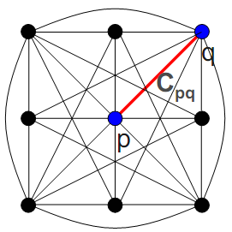
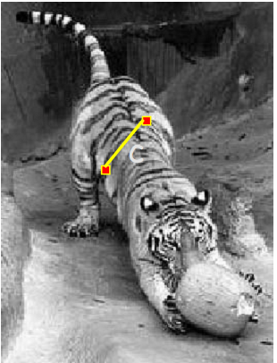
Graph Representation
Fully-connected graph
  node for every pixel
  link between every pair of pixels, p,q
  cost c_{pq} for each link
    c_{pq} measures similarity
      similarity is inversely proportional to difference in color and position

Slide 4
Segmentation by min (s-t) cut
Graph
  node for each pixel, link between pixels
  specify a few pixels as foreground and background
    create an infinite cost link from each bg pixel to the “t” node
    create an infinite cost link from each fg pixel to the “s” node
  compute min cut that separates s from t

Slide 5

Segmentation by Graph Cuts
w
A
B
C
Break Graph into Segments
  Delete links that cross between segments
  Easiest to break links that have low cost (similarity)
    similar pixels should be in the same segments
    dissimilar pixels should be in different segments

Slide 6
Energy cost functions
Energy Function is heuristic for quantization of a combination of Data Features on an N-D Image.
Simple Examples: Distance metric – Image is sent as a binary image, graph is represented as points in the plane

Slide 7
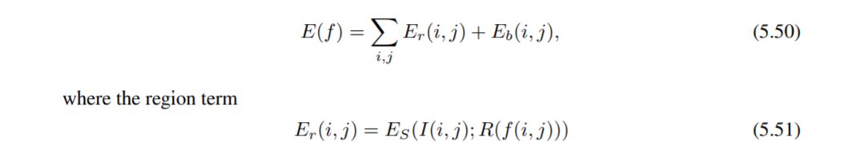
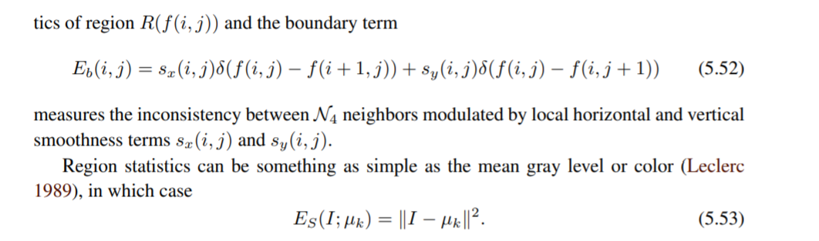
Energy cost functions

Slide 8
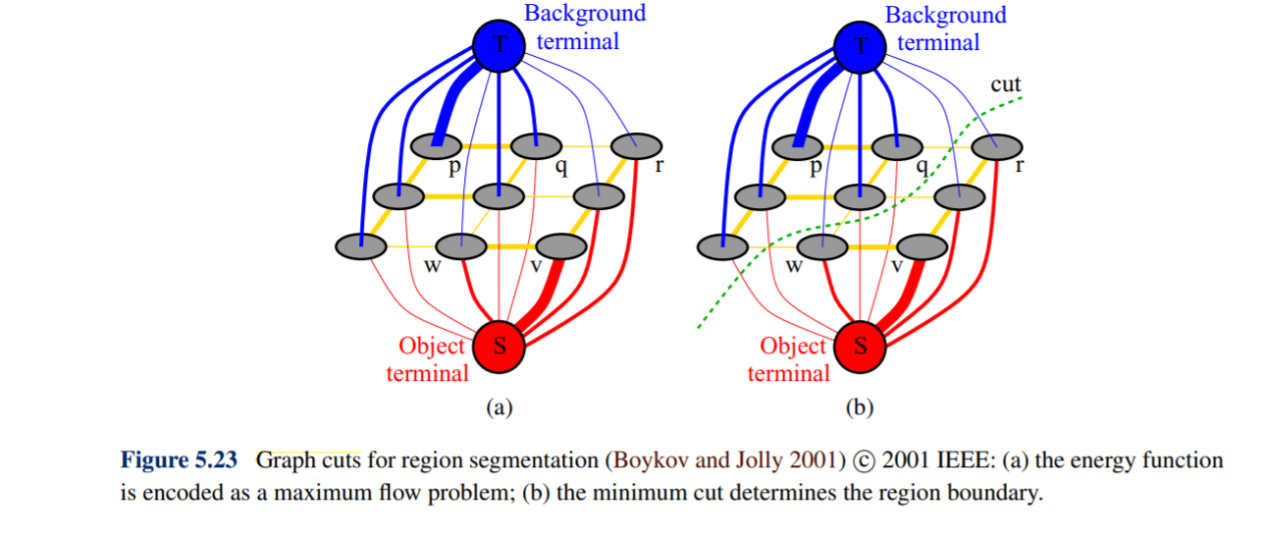

Slide 9

Energy functions for Graph Cuts
The most Natural Energy form is:
V - Boundary Penalty caused by choosing labels for 2 pixels
D – Regional Penalty for assigning a pixel to some label.

